Slide 1

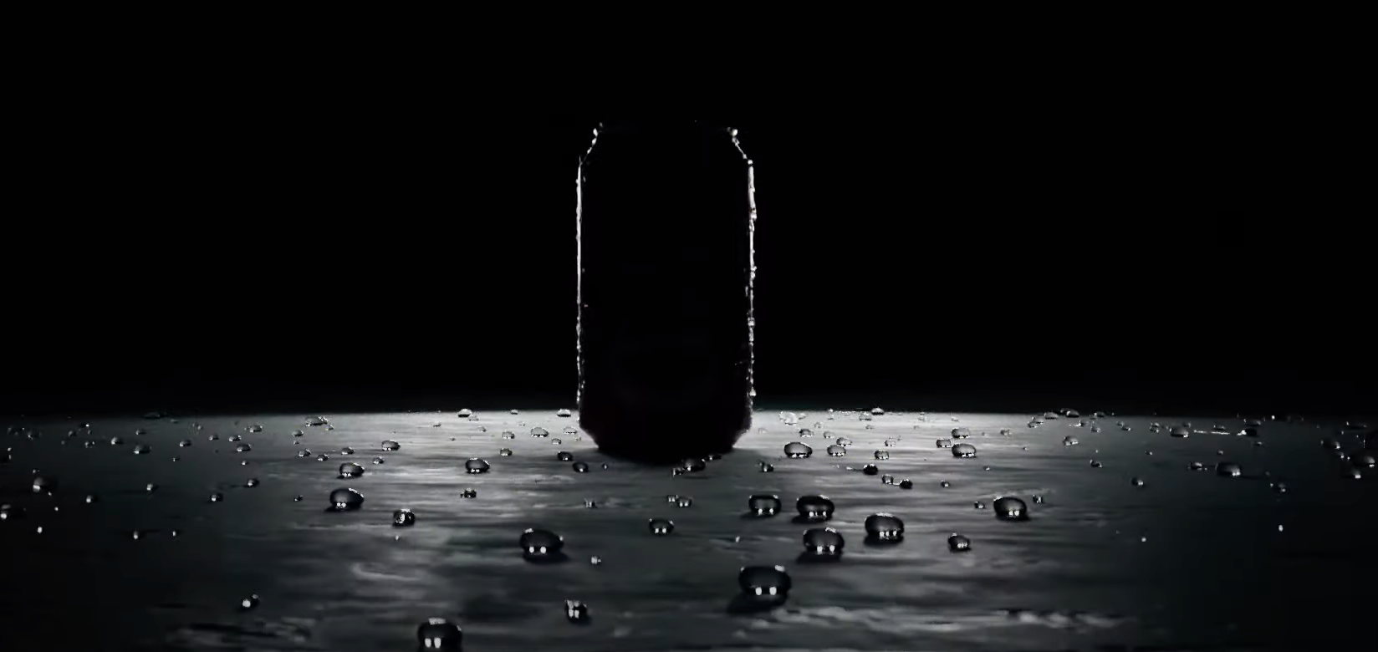


f
PREDICTIVE
MAINTENANCE
CHARITH REDDY GOPAVARAM
ADARSH FNU
DHEERAJ YATA

Slide 2

BUSINESS PROBLEM
Accurately predict machine breakdowns across all production plants to streamline maintenance processes, reduce unplanned downtime, and ensure operational efficiency while meeting 100% of production demand.
IMPACT
By leveraging predictive maintenance, the company can boost revenue, extend machine life, reduce maintenance costs, optimize spare part inventory, and enhance production capacity.

Slide 3
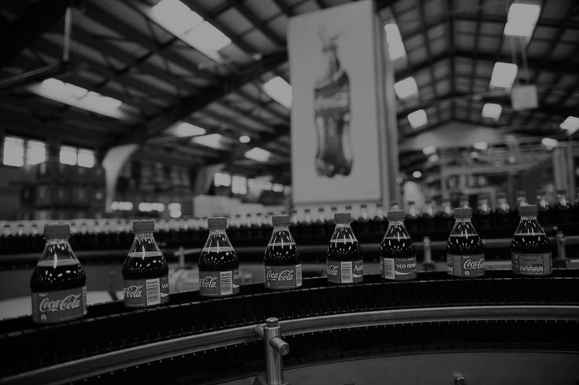
“What are the cause’s for a breakdown?”

Slide 4

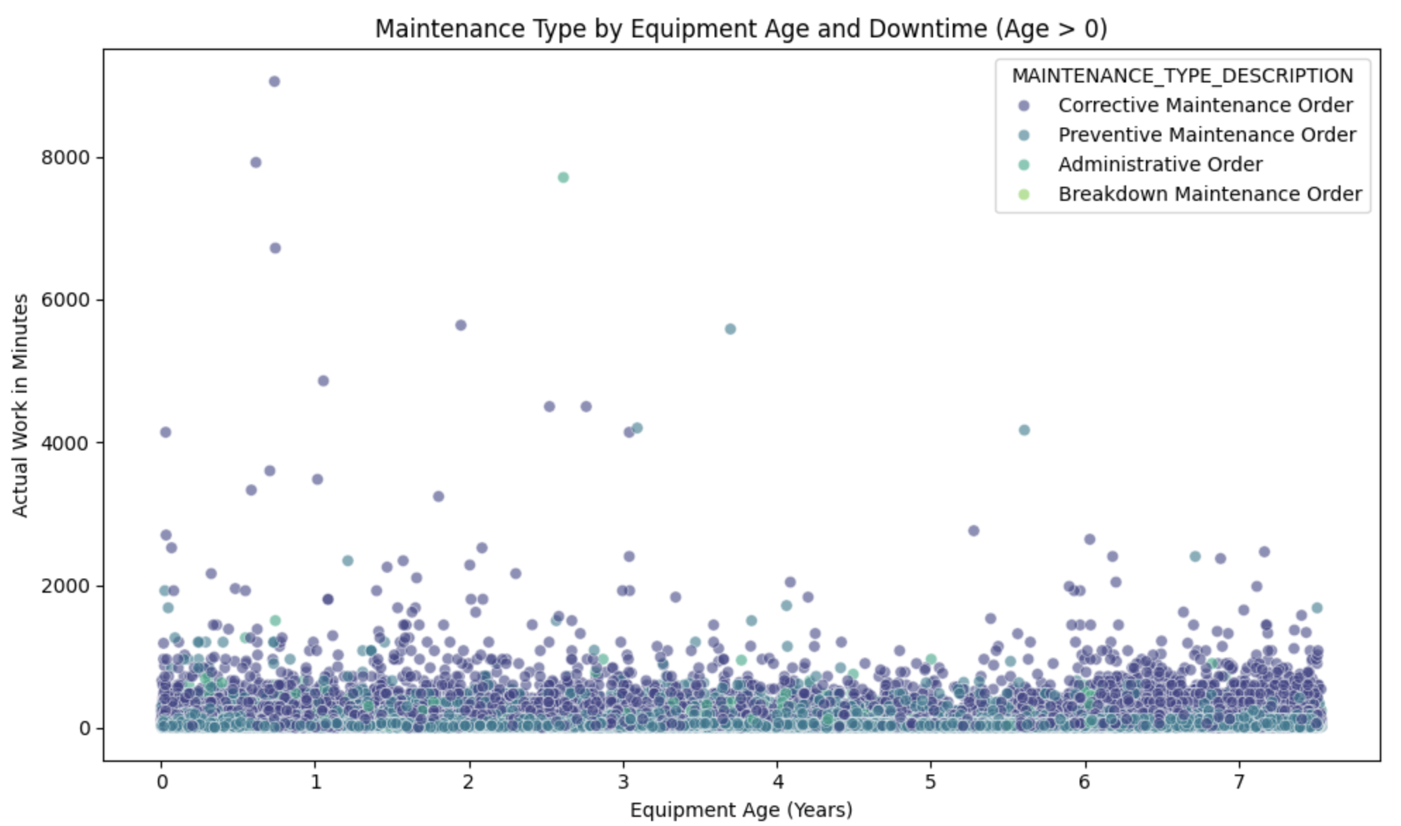
IMPACT OF AGE AND WEAR ON MACHINE PERFORMANCE
Downtime not limited to older equipment; significant in newer machines too.
Majority breakdown 0-3 years.
Corrective dominates; Preventive reduces downtime.

Slide 5
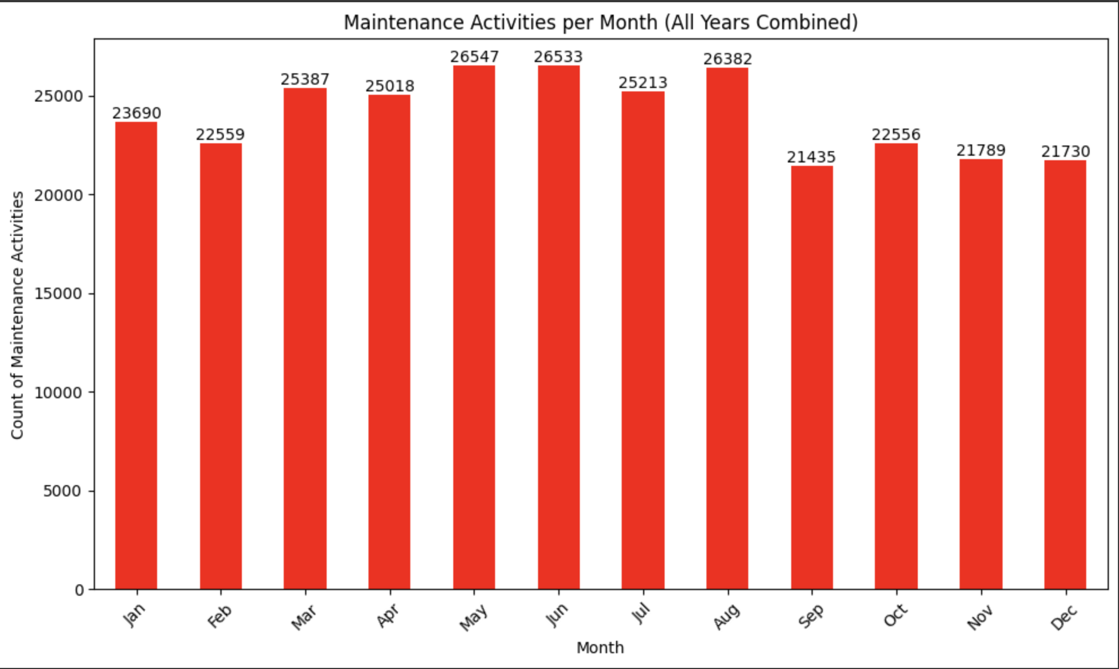
UNCOVERING SEASONAL PATTERNS
Maintenance activities peak during late spring and summer
May (26,547), June (26,533), August (26,382)
May has the highest maintenance activities, prioritize preventive strategies before this peak.

Slide 6

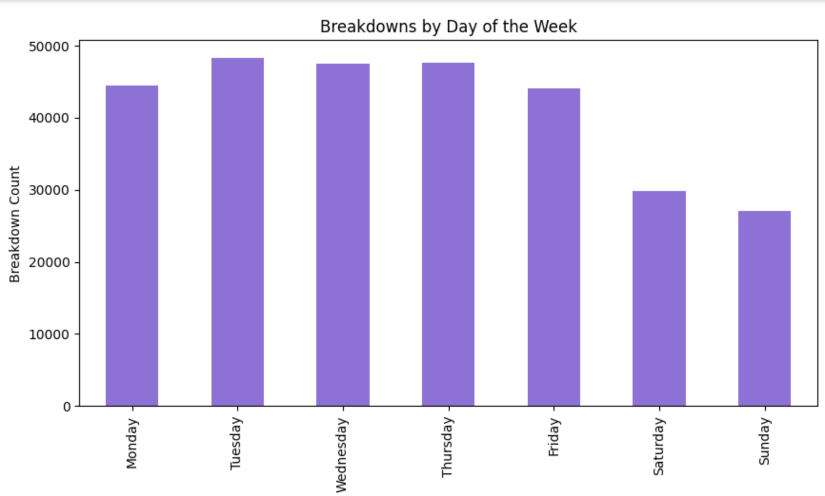
Breakdown counts are higher during weekdays, likely due to higher machine utilization during production schedules.

Slide 7

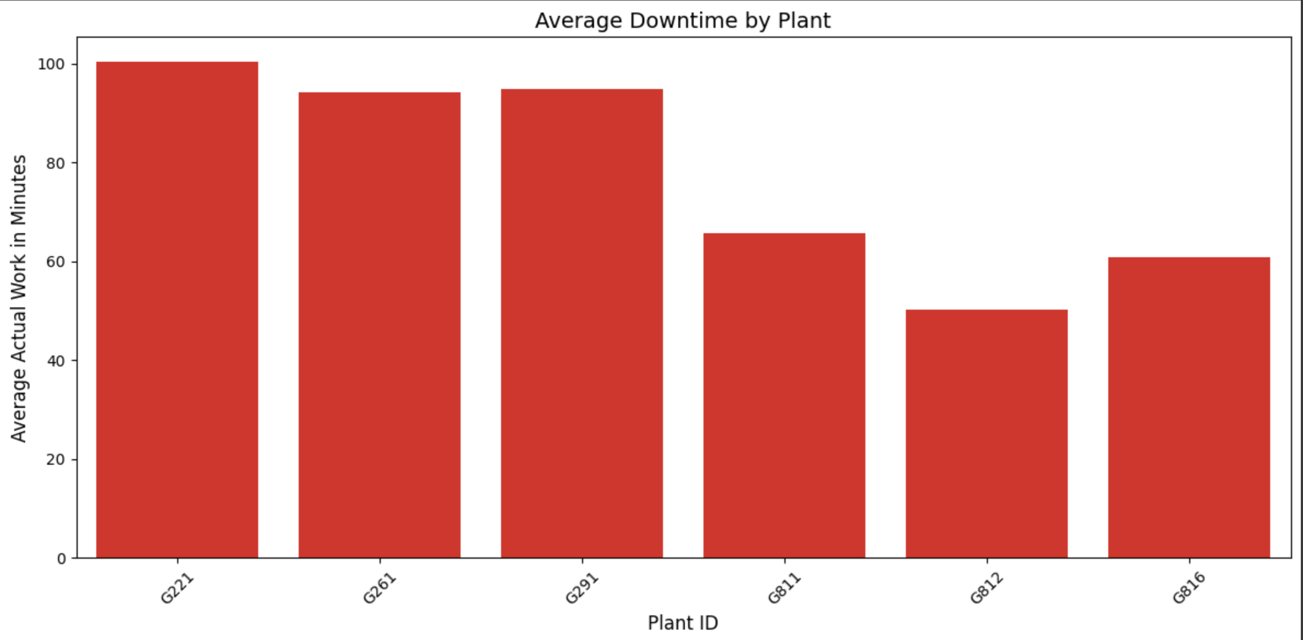
Equipment by Plant and Production Location
Suzuka (Plant ID: G221)
L04 KRONES PALLETIZER
L04 PACKR_CASE_KHS_TSP A-M
Silverstone (Plant ID: G261)
L2 LINE 2 FILLER
L2 PALLETIZER_T-TEK_TS-0075
Monza (Plant ID: G291)
L1 FILLER_ROTARY_BTL_60_VALVE
L4 FILLER_ROTARY_CAN_100_VALVE
Monaco (Plant ID: G811)
ILBM COOLING TOWER
ROGERS AIR COMPRESSOR
Roma (Plant ID: G812)
L3 FILLER_ROTARY_CAN_124_VALVE
CAN LINE 3 SEAMER
Cota (Plant ID: G816)
L1 FILLER_ROTARY_CAN_72_VALVE
L3PACKR_CASE_WESTROCK_DD1250M
SUZUKA
SILVERSTONE
MONZA
MONACO
ROMA
COTA

Slide 8

TOP EQUIPMENT PERFORMANCE AND BREAKDOWN INSIGHTS
EQUIPMENT ID | BREAKDOWN COUNT | AVERAGE MTBF (DAYS) | EQUIP_CAT_DESC | EQUIPMENT_DESC | EQUIPMENT CATEGORY
300115000 | 3743 | 0.476760 | MACHINES | L1_FILLER_ROTARY_CAN_72_VALVE | FILLER
300001113 | 2736 | 0.998537 | MACHINES | L1_FILLER_ROTARY_BTL_60_VALVE | FILLER
300001510 | 2509 | 1.088118 | MACHINES | L4_FILLER_ROTARY_CAN_100_VALVE | FILLER
300001505 | 2070 | 1.320445 | MACHINES | L2_FILLER_ROTARY_BTL_45_VALVE | FILLER
300001078 | 1851 | 1.473514 | MACHINES | L4 SEAMER_ROTARY | SEAMER
300001276 | 1574 | 1.736173 | MACHINES | L4 PACKER_CASE | PACKER
300001133 | 1534 | 1.778213 | MACHINES | L3 PACKER KHS TSP80V | PACKER

Slide 9

EQUIPMENT AT RISK
EQUIPMENT ID | EQUIP_AGE (DAYS) | PLANT ID | PRODUCTION LOCATION | RISK STATUS
300115000 | 1789.0 | G816 | COTA | AT RISK
300001113 | 2752.0 | G291 | MONZA | AT RISK
300001510 | 2750.0 | G291 | MONZA | AT RISK
300001505 | 2751.0 | G291 | MONZA | AT RISK
300001078 | 2739.0 | G291 | MONZA | AT RISK
300001276 | 329.0 | G291 | MONZA | AT RISK
300001133 | 2742.0 | G291 | MONZA | AT RISK

Slide 10

MACHINE LONGEVITY WITH MEDIAN SURVIVAL DAYS
EQUIPMENT CATEGORY | FAILURE FREQUENCY | MEDIAN SURVIVAL DAYS
FILLER | 46,322 | 1,177
PACKER | 35,320 | 1,193
CONVEYER | 34,765 | 1,139
LABELER | 18,945 | 1,524
Calculated from Functional Area Node 4.
High occurrences in Filler and Packer.
Labeler has higher survival despite lower failure frequency

Slide 11
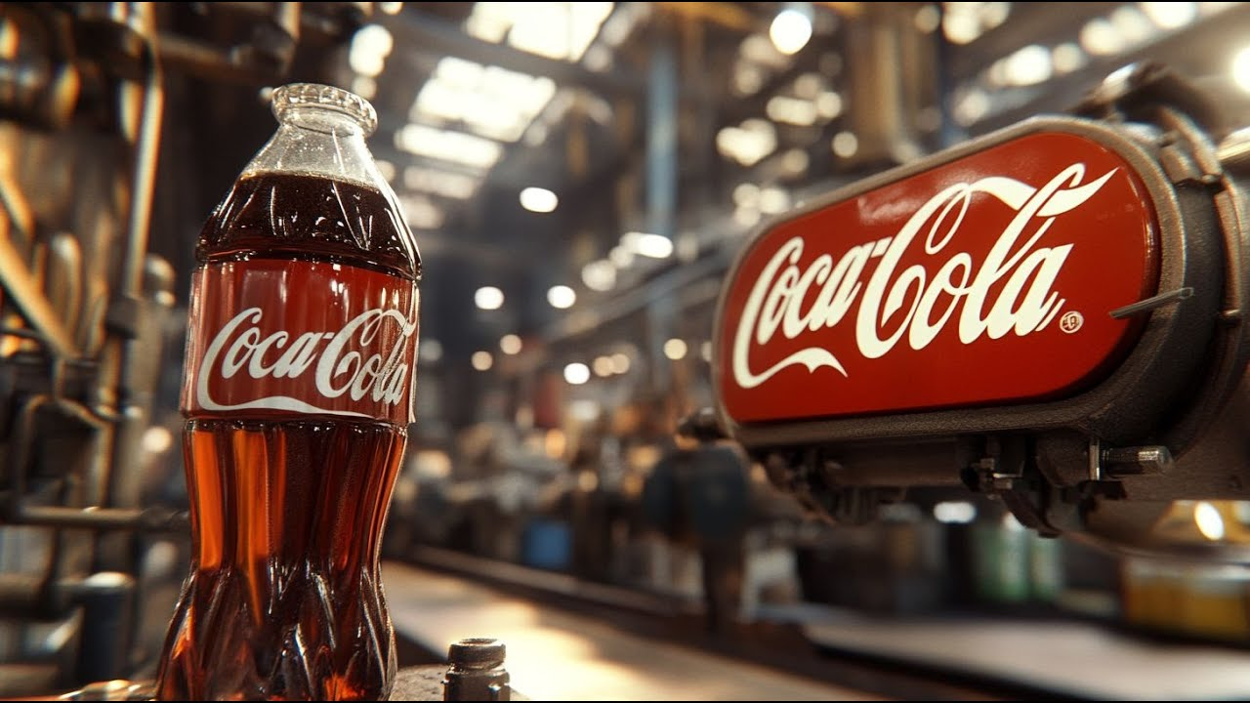
“HOW WE COULD REDUCE DOWNTIME”

Slide 12

IMPACT OF PROACTIVE MAINTENANCE
HIGH-RISK EQUIPMENT : Fillers, packers, labelers with low MTBF and high downtime.
MEDIAN SURVIVAL DAYS : What if we implement proactive interventions before median survival days.
PROACTIVE INTERVENTIONS: Identifies and resolves potential equipment failures before they occur.
PREVENTIVE MEASURES : Potential to reduce unplanned breakdowns by 70 % and reduced costs.
BUSINESS IMPACT: Improved efficiency, reduced downtime, and significant cost savings.

Slide 13
SIGNIFICANTLY REDUCING DOWNTIME HOURS
EQUIPMENT | CURRENT DOWNTIME (HOURS) | OPTIMIZED DOWNTIME (HOURS)
L1 FILLER_ROTARY_CAN_72_VALVE | 5531.29 | 618.41
L3 FILLER_ROTARY_BTL_100_VALVE | 3661.61 | 789.19
L1 FILLER_ROTARY_BTL_60_VALVE | 2948.87 | 820.98
L4 FILLER_ROTARY_CAN_100_VALVE | 3310.47 | 782.22
MICROBLEND MICRO2 BLENDER (LINE 1) | 43.58 | 29.03
MICROBLEND MICRO2 BLENDER (LINE 3) | 32.13 | 20.13
L2 LINE 2 FILLER | 810.9 | 0
CAN LINE 3 GPI PACKER | 898.80 | 98.83

Slide 14
STRATEGIC IMPACT: REDUCING DOWNTIME THROUGH INVENTORY
EQUIPMENT | FAILURES (COUNT) | DOWNTIME WITHOUT INVENTORY (HOURS) | DOWNTIME WITH INVENTORY (HOURS)
L1 FILLER_ROTARY_CAN_72_VALVE | 3745 | 7490 | 1872.5
L1 FILLER_ROTARY_BTL_60_VALVE | 2738 | 5476 | 1369
L4 FILLER_ROTARY_CAN_100_VALVE | 2511 | 5022 | 1255.5
L2 FILLER_ROTARY_BTL_45_VALVE | 2072 | 4144 | 1036
L3 FILLER_ROTARY_BTL_100_VALVE | 1474 | 2948 | 737

Slide 15

BUSINESS RECOMMENDATIONS
IMPLEMENT PROACTIVE MAINTENANCE STRATEGIES
INVENTORY MANAGEMENT
PRIORITIZE HIGH-RISK EQUIPMENT AND PLANT’S
SEASONAL MAINTENANCE

Slide 16
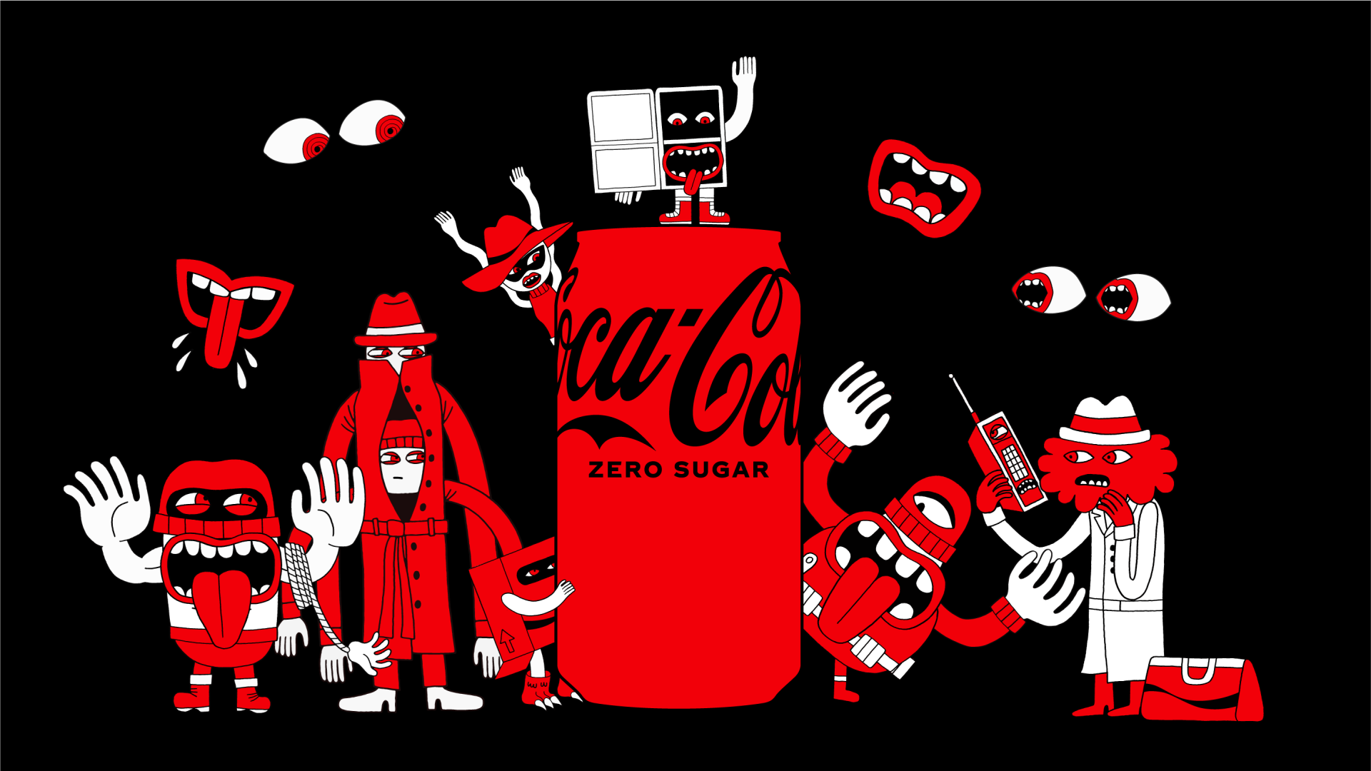
Thank You

